Slide 1
PROJECT ON LUMA WEB APPLICATION
TEAM MEMBERS
Amit A J
Hruthik G M
Pramod Gowda T S
Rahul C K
Rohith G
Vinay S M
TEAM LEAD
Mr. Chandan N R
Ms. Navya

Slide 2
CONTENTS
INTRODUCTION
ABOUT LUMA WEB APPLICATION
WHEN USER CLICK ON DIFFERENT MODULE AND FEATURE IT SHOULD DISPLAY DIFFERENT WEB PAGE
TABLE 1.0 TOOLS USED
TABLE 1.1 PLAN OF ACTION AND NUMBER OF DAYS REQUIRED

Slide 3
INTRODUCTION
LUMA is one of the E-commerce web applications and it as more than 230 stores spanning 43 states and growing, Luma is a nationally recognized active wear manufacture and retailer and they are passionate about active lifestyles way beyond apparel. Luma differentiate ourselves through a combination of unique designs and styles merged with unequaled standards of quality and authenticity.

Slide 4
ABOUT LUMA WEB APPLICATION
Luma is one of the E-commerce application and contains different modules like
Women
Men
Gear
Training
Sale
1. Women module – this module contains top and bottom wear features for the women.
Top feature contains sub feature called jackets, hoodies & sweat shirt, tees & tanks.
In jackets feature there are different colors of jackets are present with different size, style, material used and price and they are mentioning details of the products.
And we can also sort the product by position, product name and price.

Slide 5
Bottom feature contains pants and shorts for women in different style, size, price, colors, and they also mention the details of the product. if we want, we can sort the product by Eco collection, Performance fabric, Climate etc.…
2. Men module - this module contains top and bottom wear features for the men.
Top feature contains sub feature called jackets, hoodies & sweat shirt, tees & tanks.
In jackets feature there are different colors of jackets are present with different size, style, material used and price and they are mentioning details of the products.
And we can also sort the product by position, product name and price.
3. Gear Module – this module contains bags, fitness equipment and watches.
Bags feature contains different types bags and we can sort products like style, price, activity, material, handle etc…
Fitness equipment feature contains different equipment like sprite yoga companion kit and it contains well-rounded yoga work-out takes more than a mat. The spirit yoga Companion kit helps stock your studio with the basics you need for a full-range workout.

Slide 6
The kit is composed of four best-selling Luma Spirit accessories in one easy bundle: statis ball, foam block, yoga strap, and foam roller. We choose that kit based on size and colors, like that Fitness equipment contains different equipment based on category, size, colors, and gender we can sort product.
Watches feature – it is also a one of the features of Luma application and it contains different types of analog and digital watches for both men and women.
In this feature also we can sort the different types of watches by gender, price, category, material etc.
4. Training Module – this module contains video download feature.
Video download – In this feature we can compare the products by adding the products into add to compare and it will describe the products details by comparing all the product. If we want to take that comparing products pic their will be one option called print this page, once it will print we make that document because of that chances are their customer might like the application.
Sales Module – this module contains all main module of the application like Women, Men, Gear and Training along with they are also providing the offers for the specific product.

Slide 7
Why customer might like this application?
Because in any other E-commerce application if we want take that comparing product picture there is no option to take snap of that compared product in the application it self but in this application, we can take the snap of that in the application it 'self and we can document it. So chances are their customer might like this application.
Because of that feature adopted in this application user can send that document to any one of the family member(ex. parent) and friends with the quality picture along with price, rating, and the product name to asking their opinion to buy the product or not.
In this application also they are providing the offers along free delivery of the product to customer place.
User interface of the application is good and it attracts the customer so customer might like this application.

Slide 8
Tools Used
Selenium Tool(Version 4.8.1)
Maven Repository
Poi Library(Version 5.2.3)
TestNG(Version 7.4.0)
Table 1.0 Tools Used
Plan Of Action | No Of Days Required
Writing Test Scenarios | 03-04
Test Plan | 02
Writing Test Cases | 02-03
Writing Test Cases | 06-08
Execution Of Scripts | 05-06
Table 1.1 Plan of Action and Number of Days Required

Slide 9
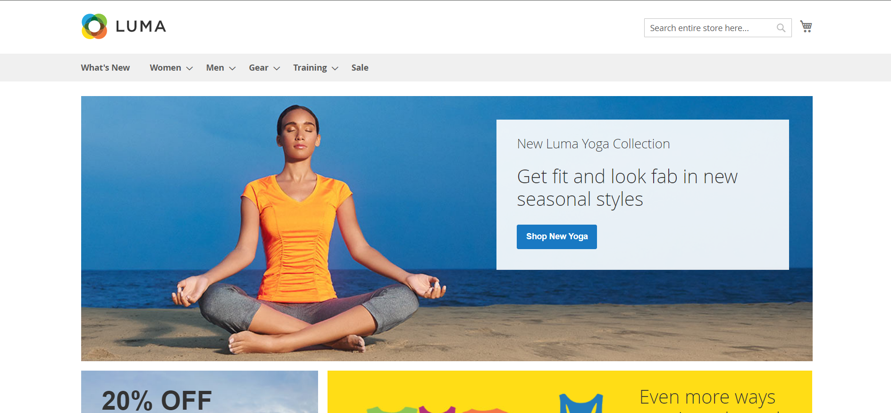
When User Click On Different Module and Feature It Should Display Different Web Page When User Trigger’s the Main Url Of The Application it should display Home page of the Luma application.
Home Page Of Luma Application

Slide 10
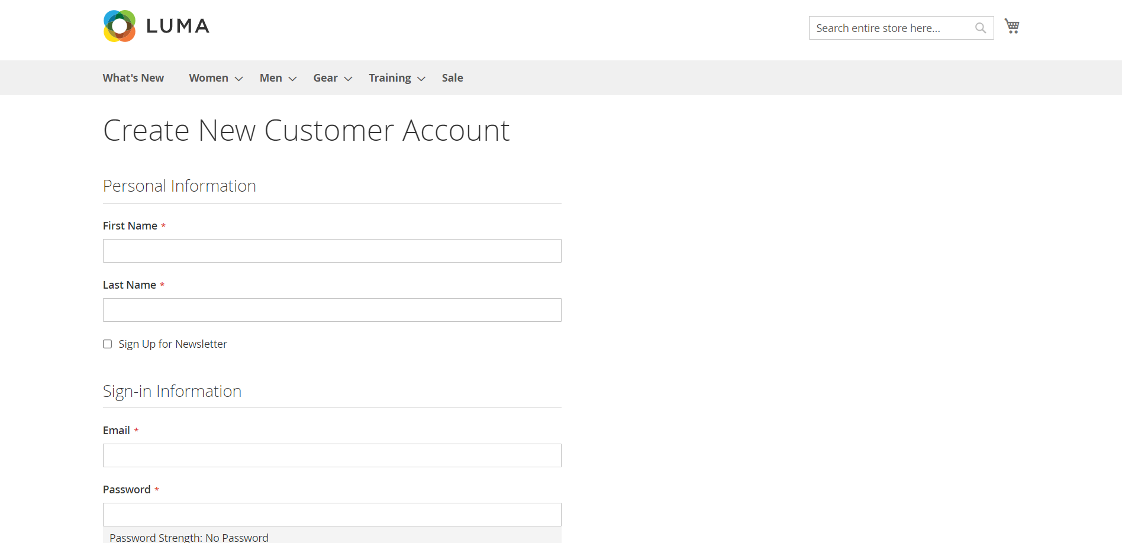
When user Click on Create an Account it Should display Create New Customer Account page
New Customer page

Slide 11
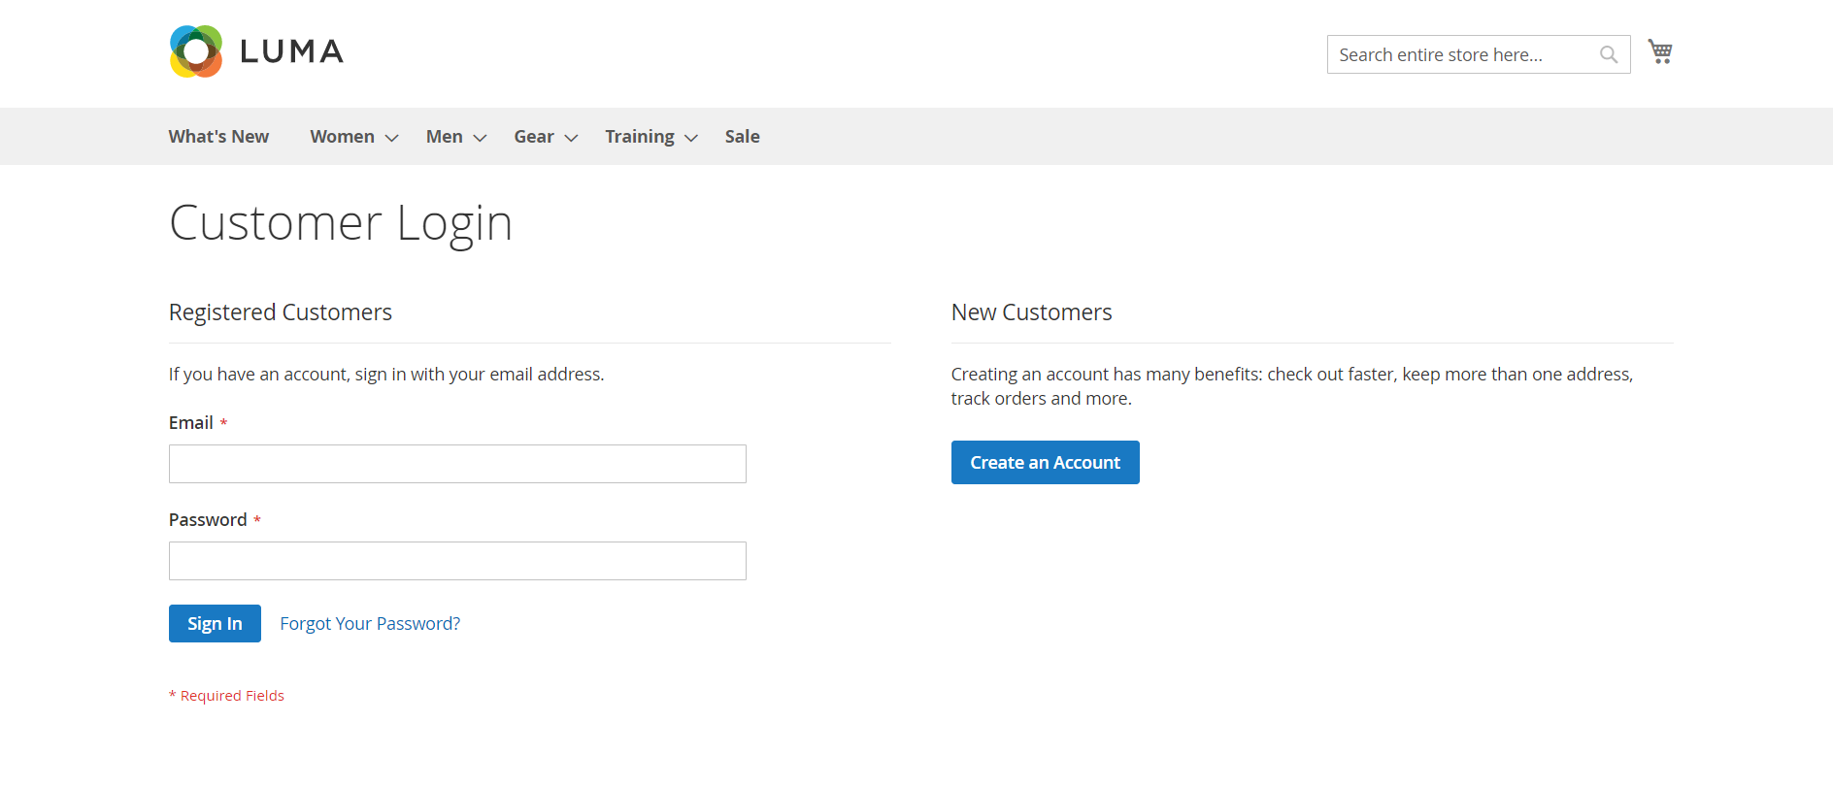
When User Click On Sign in it should display Customer Login Page
Customer Login Page

Slide 12
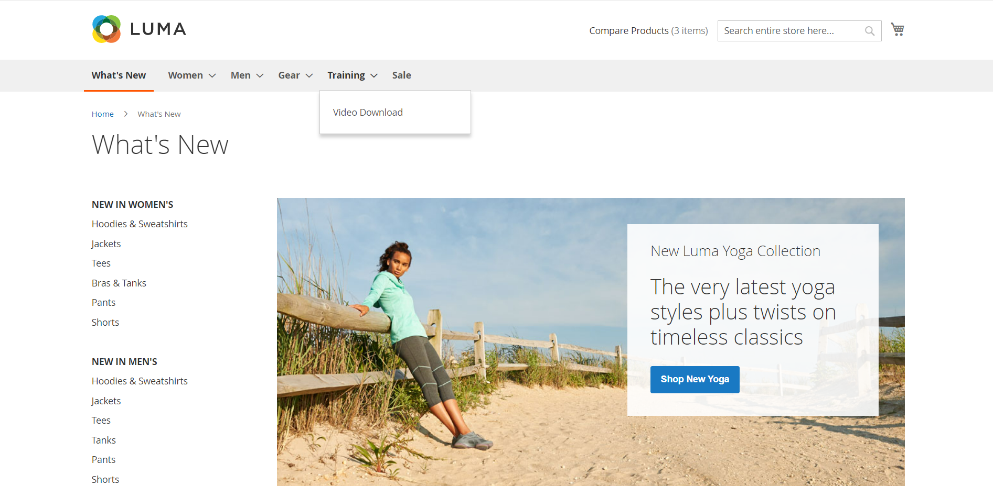
When User Click On What’s New Module It Should Display What’s New Page
What’s New Page

Slide 13
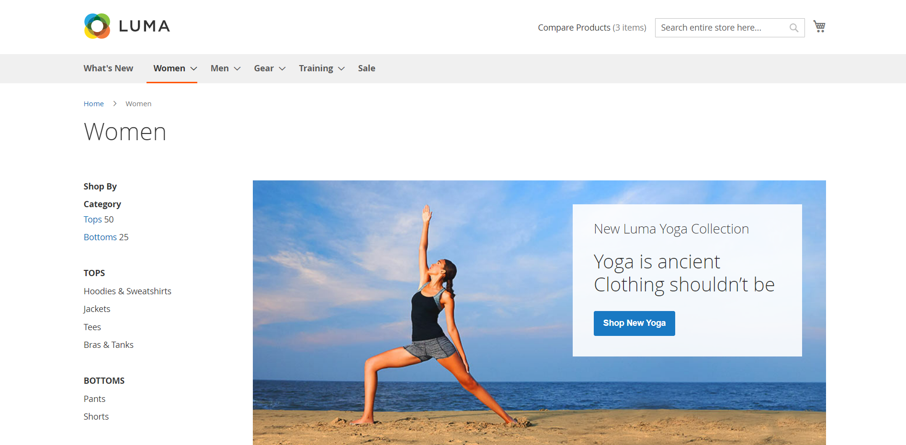
When User Click On Women Module It Should Display Women Page
Women Page

Slide 14
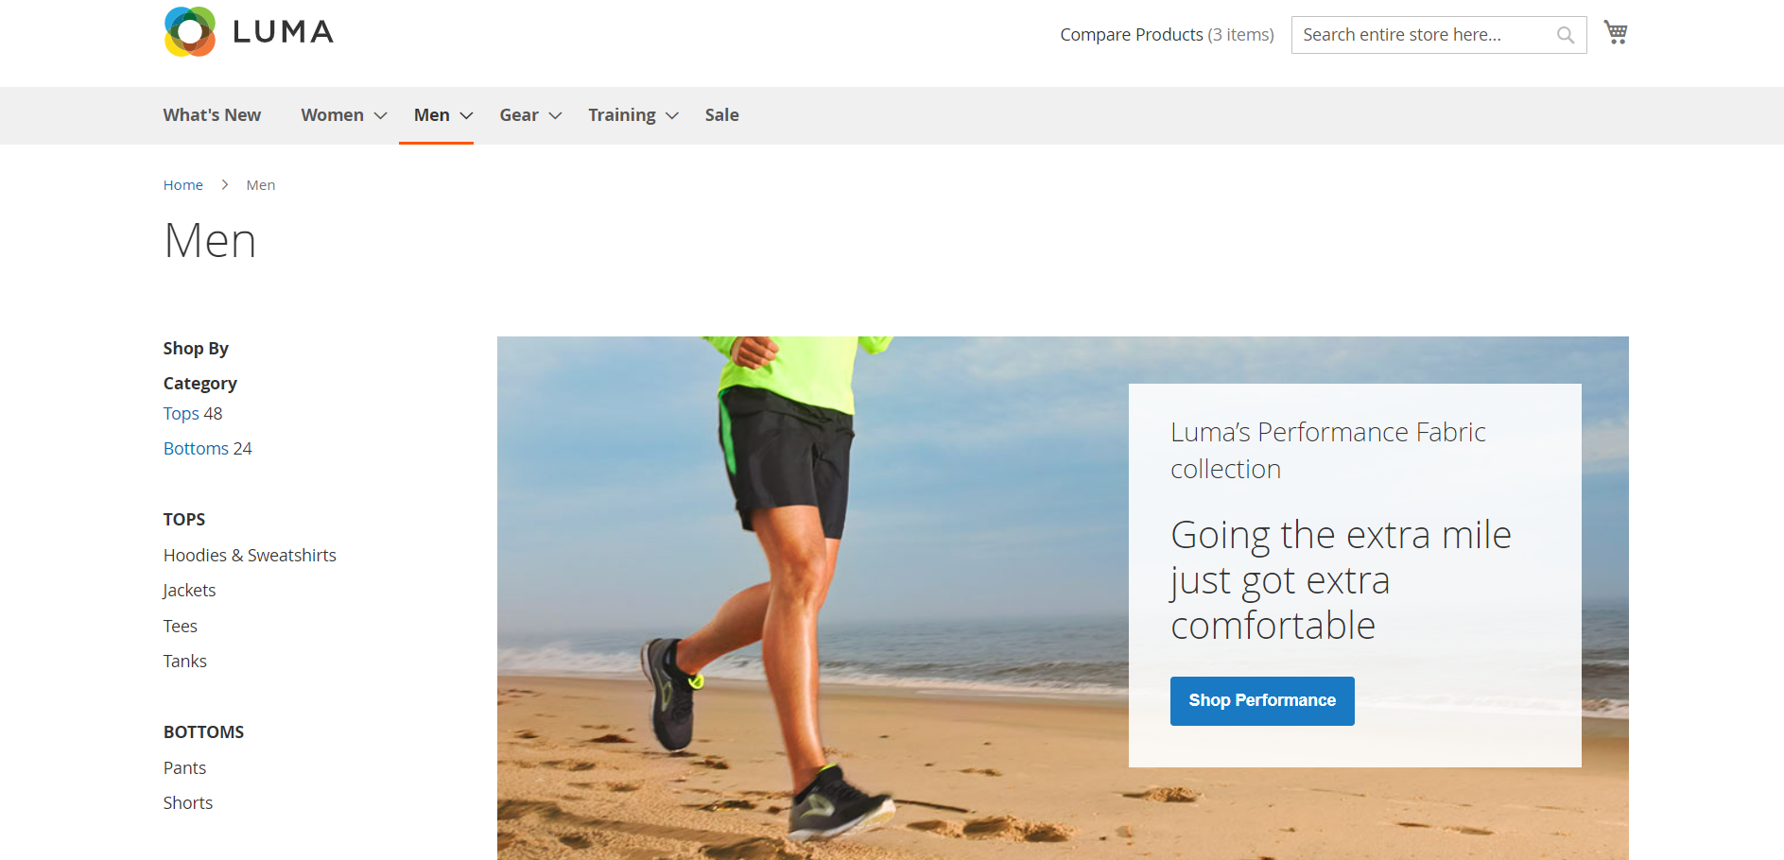
When User Click On Men Module It Should Display Men Page
Men Page

Slide 15
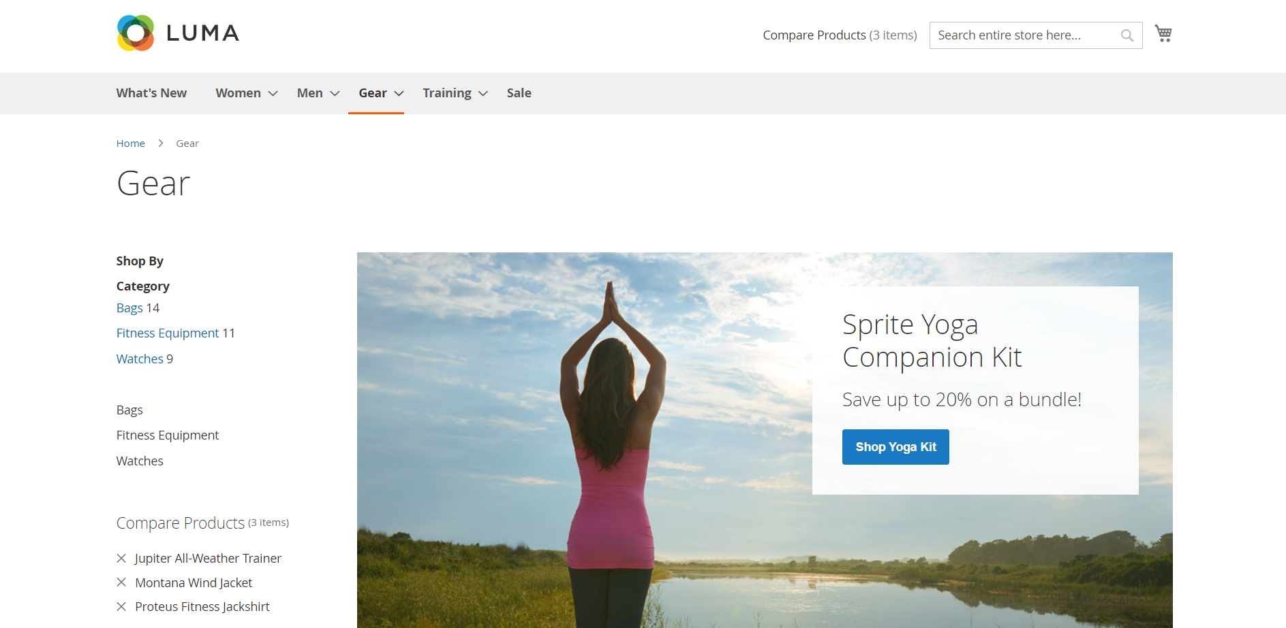
When User Click On Gear Module It Should Display Gear Page
Gear Page

Slide 16
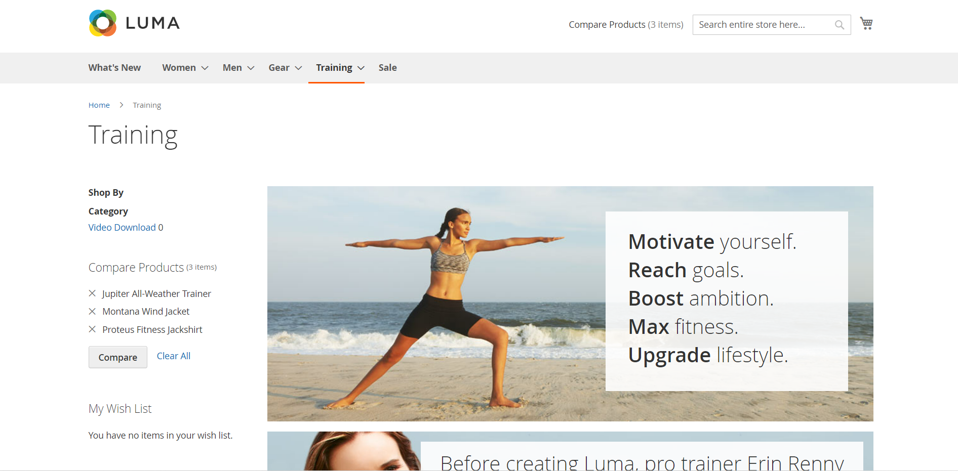
When User Click On Training Module It Should Display Training Page
Training Page

Slide 17
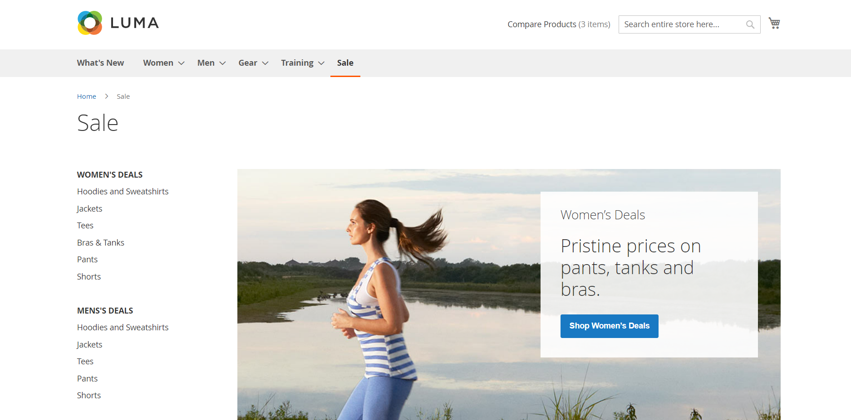
When User Click On Sale Module It Should Display Sale Page
Sale Page

Slide 18
When User Click On Logo of the Application It Should Display Home Page
Home Page

Slide 19
THANK YOU

